Slide 1

WELCOME TO ENGLISH CLASS

Slide 2
WELCOME TO ENGLISH CLASS
“Be the change that you wish to see in the world."
Mahatma Gandhi

Slide 3
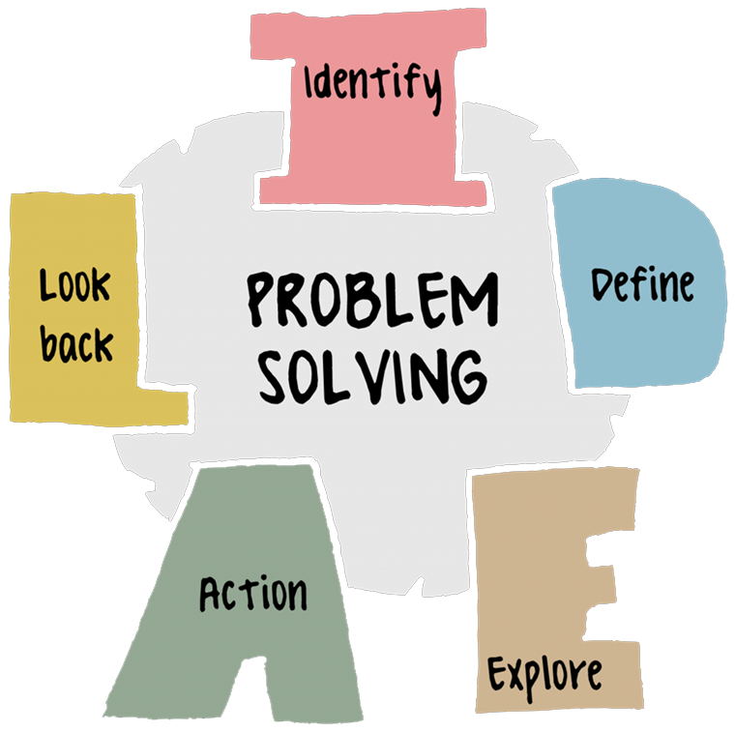
IDEAL METHOD

Slide 4

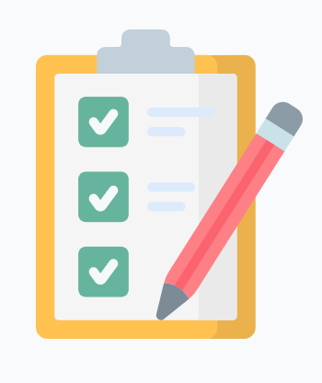

DATE
DATE
Objective:
Students will demonstrate their understanding of the IDEAL method by writing a short summary of the text

Slide 5

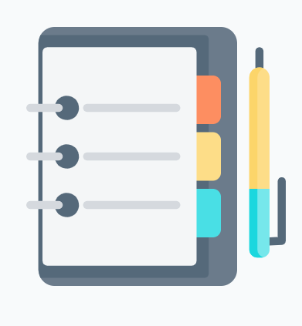


AGENDA
WARM UP:
Make the longest Word
CLASS ACTIVITY:
Let’s share the Vocabulary
Match activity
Reading Strategy (video)
Reading the Text: “Using the IDEAL Problem Solving Method in Groups”.
Wrap- Up
Complete the sentences using the Information about the IDEAL method

Slide 6
WARM-UP
HONORIFICABILITUDINITATIBUS
Make the longest word
Make the longest word using each letter of the words.
I D E A L, ACTION,
Example:
I D E A L
Insect dinosaur

Slide 7
VOCABULARY
I.
Identify the problem
Identification
Definition
Exploration
Action
Look at effect or Learn from actions
L.
Look at the effects
D.
Define the problem
A.
Act on strategies
E.
Explore solutions

Slide 8
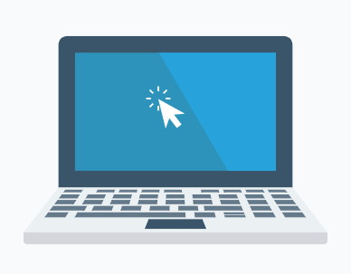
Match the problem with the IDEAL method order using the previous information, put the correct answer in the A column
COLUMN A
COLUMN B
1) The trash gets taken out before the trash pickup day tomorrow."
2) The trash gets taken out before the trash pickup day tomorrow."
3) "I use something else for a trash bag; I place an online order for bags; I take the trash out without a bag; I ask a neighbor for a bag; I go shopping for trash bags."
4) I'll buy an extra box of trash bags to have them on hand, so I don't run out next time."
5) "I ran out of trash bags because I forgot to put them on the shopping list..
Identification
Definition
Exploration
Action
Look at effects or Learn from actions

Slide 9

Video Reading Strategy “Locate Key Words and Main Ideas”
https://youtu.be/wMxi6mMYdqE

Slide 10

Video: Main Idea
https://youtu.be/xJGQIYU_xhs

Slide 11
Text “Using the IDEAL Problem Solving Method in Groups
In introductory psychology courses, the desire to cover content can conflict with the desire to acquaint students with psychological thinking processes. The IDEAL method is a group problem solving quiz technique which addresses both of these goals. In the process, instructors choose key concepts from a given reading and divide the class into groups of four to six students. Each member of each group then chooses a concept to specialize in, completing concept sheets which compare and contrast their concept to other assigned concepts. Groups then determine how to apply their understandings of their concepts to common situations, such as when an individual decides to accompany a group to an event that they do not believe will be enjoyable.

Slide 12
Text “Using the IDEAL Problem Solving Method in Groups
Testing is conducted in essentially the same format, with quizzes evaluated on the basis of how aspects of the scenario exemplify the concept in action or how the students apply the concept to the scenario in order to address the question. The advantages of this method for psychology classes are that it makes use of student learning and gives them practice with problem solving, critical thinking, and group interaction skills while teaching the content of the subject area. A disadvantage is that the amount of material covered must be reduced to allow for time spent on problem solving techniques and teamwork skills
Text “Using the IDEAL Problem Solving Method in Groups”. TAKEN FROM: Smith, R. Scott Publication Date: 1995-Mar
https://eric.ed.gov/?id=ED389365

Slide 13
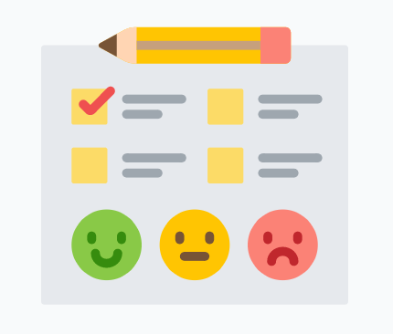
WRAP-UP
Complete the following sentences using the information about the IDEAL method.
You use the IDEAL method to _______________
The first step to solve a problem is _______________
Action taking is using to _______________
The IDEAL method is good because _______________
The second step to solve a problem is _______________

Slide 14
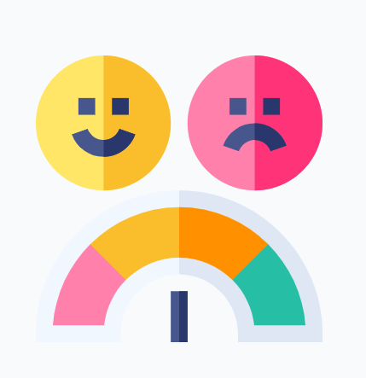
SELF-EVALUATION
Complete the following self evaluation
1. Comprendo la importancia del uso del “IDEAL método” para resolver problemas.
Si No De pronto
2. Entiendo los pasos a seguir para resolver un problema.
Si No De pronto
3. Puedo usar el “IDEAL método” para resolver un problema.
Si No De pronto

